Slide 1
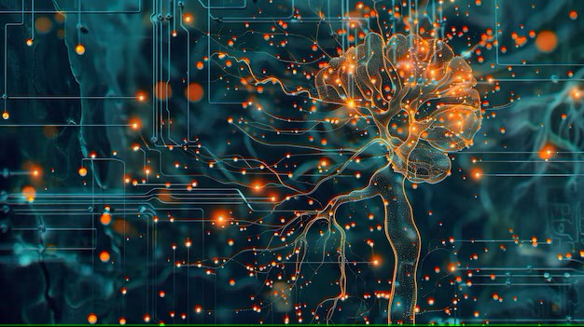


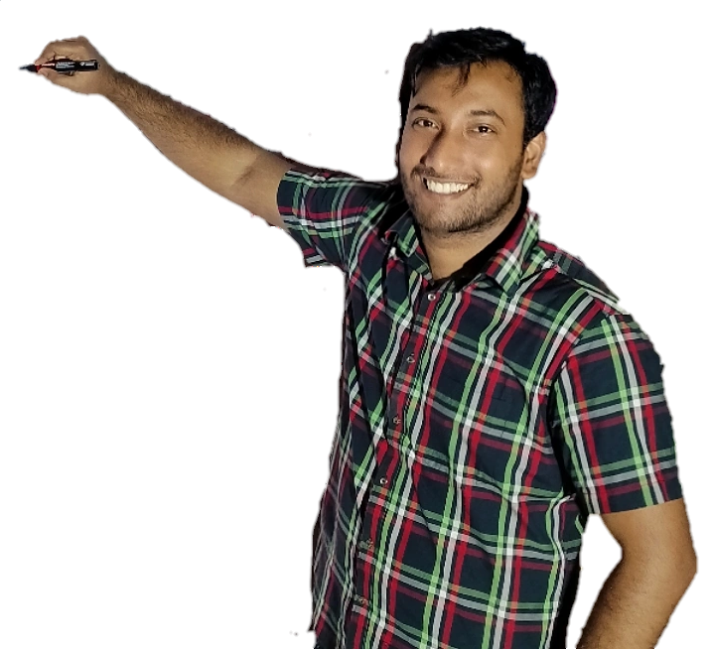
Week-11 (Discussion)
4th Apr, 2025
Deep Learning
Prof. Sudarshan Iyenger
Professor and Head of the Department
Department of Computer Science and Engineering
IIT Ropar
Ayan Paul
PMRF Research Scholar
IIT Kharagpur

Slide 2
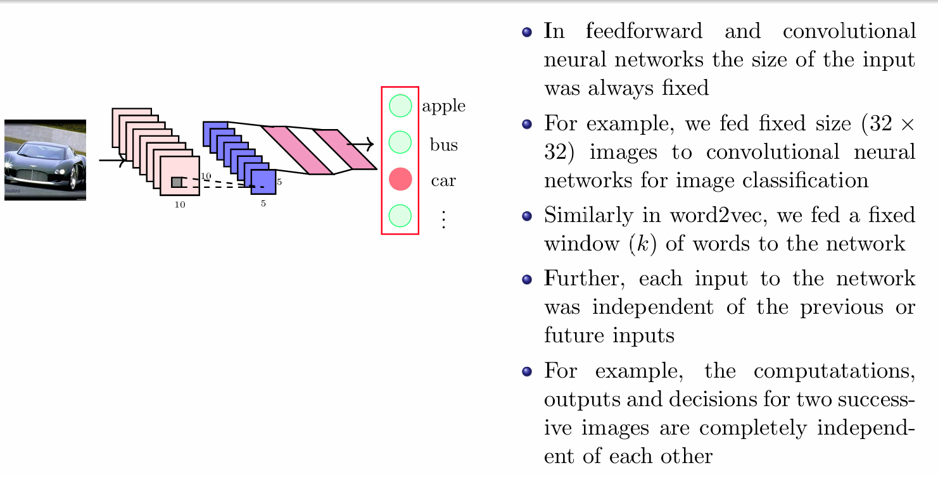
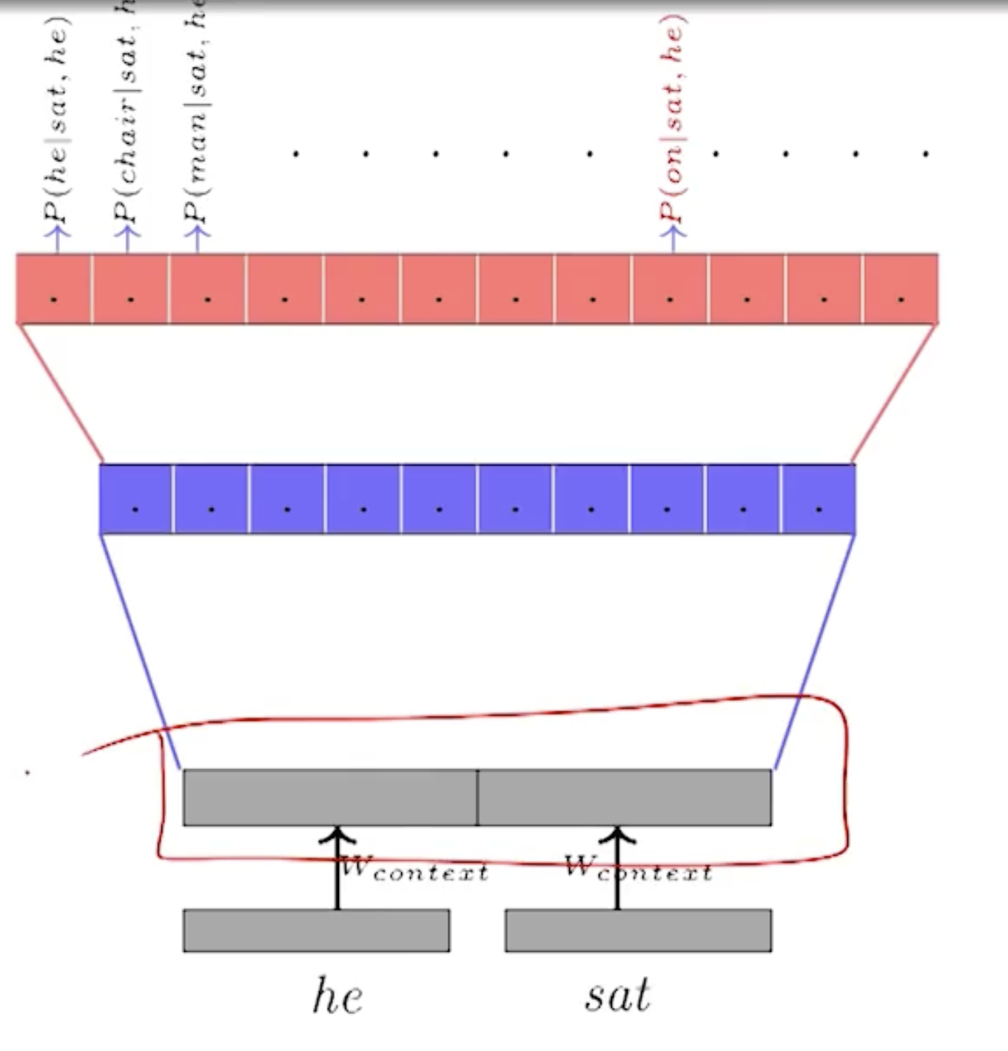
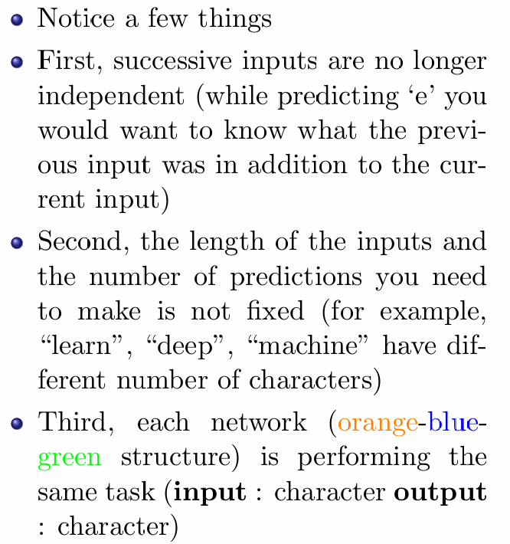
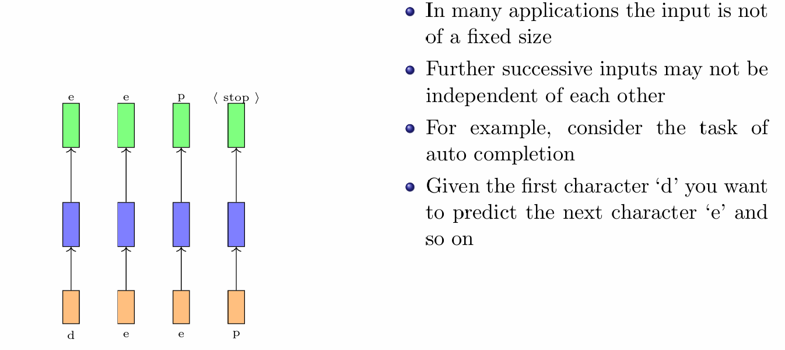
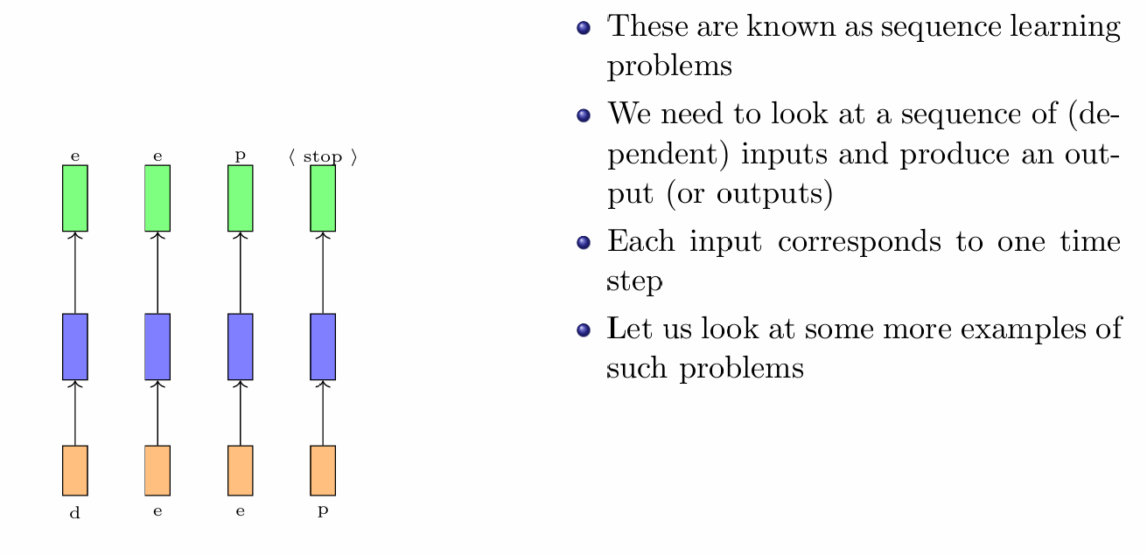
Limitations of Feedforward Neural Networks
Sequence Learning Problems

Slide 3
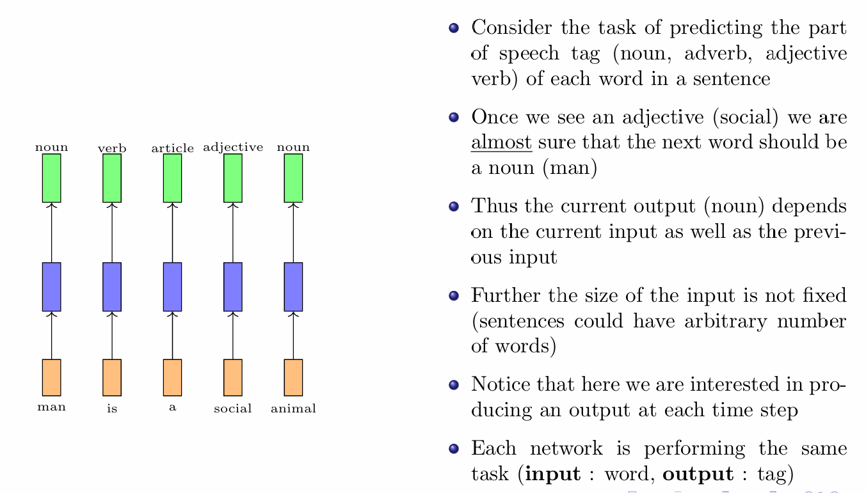
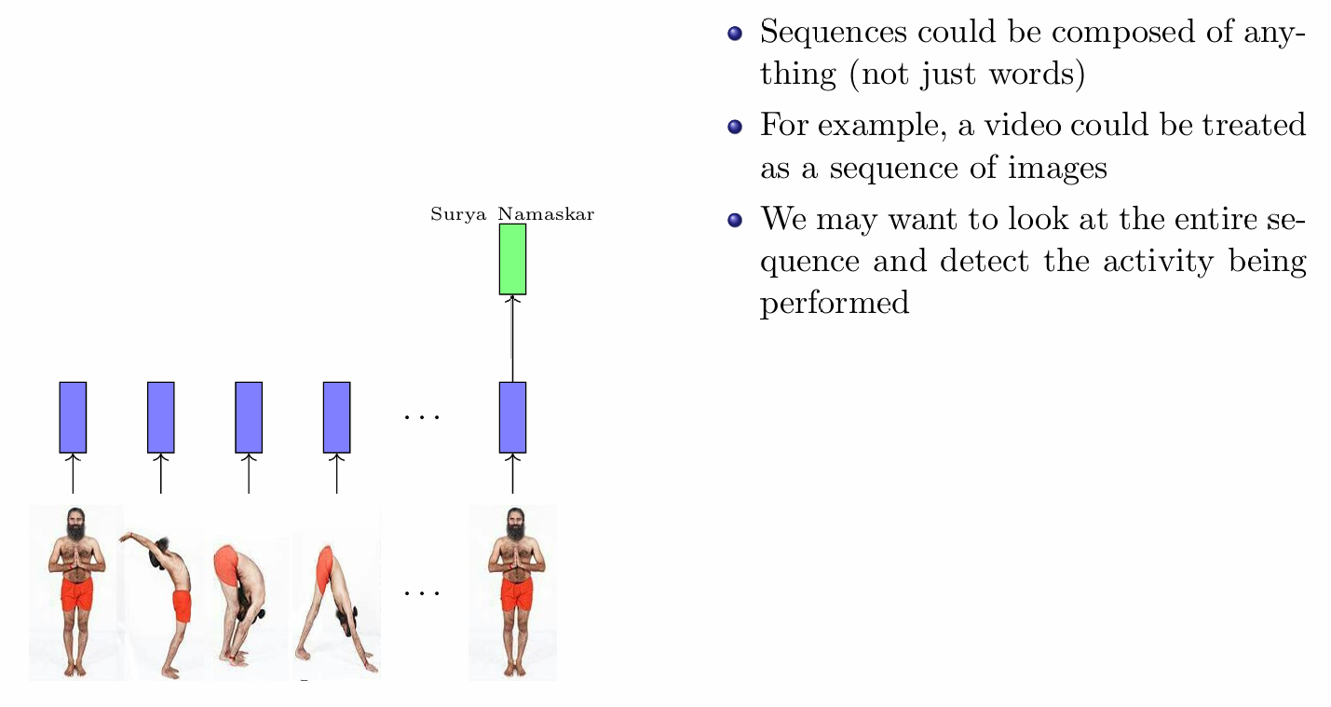
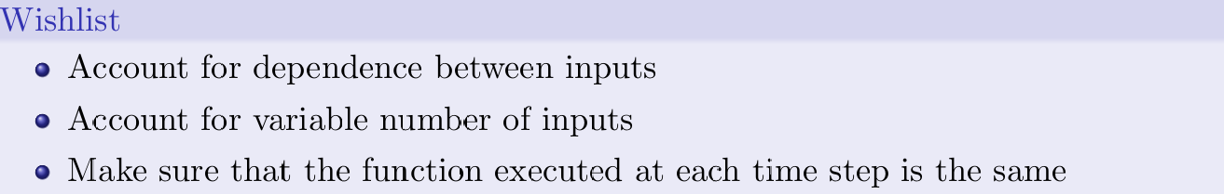
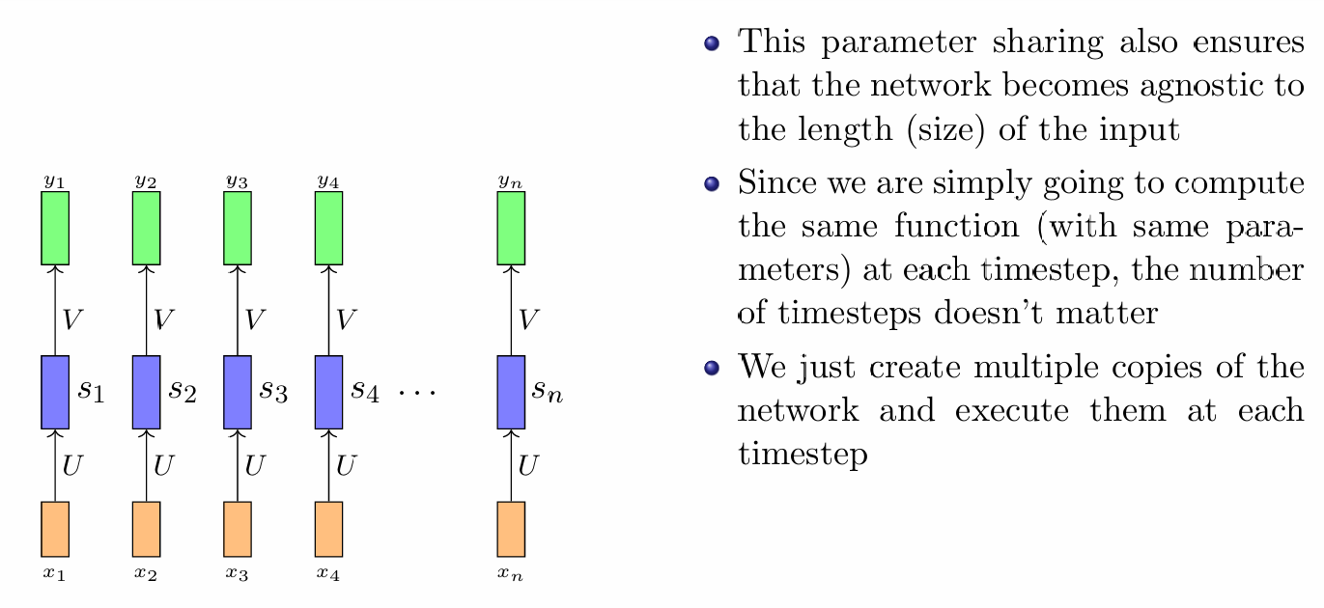
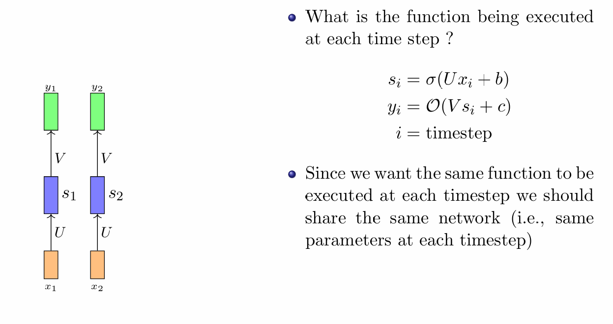
Recurrent Neural Networks

Slide 4
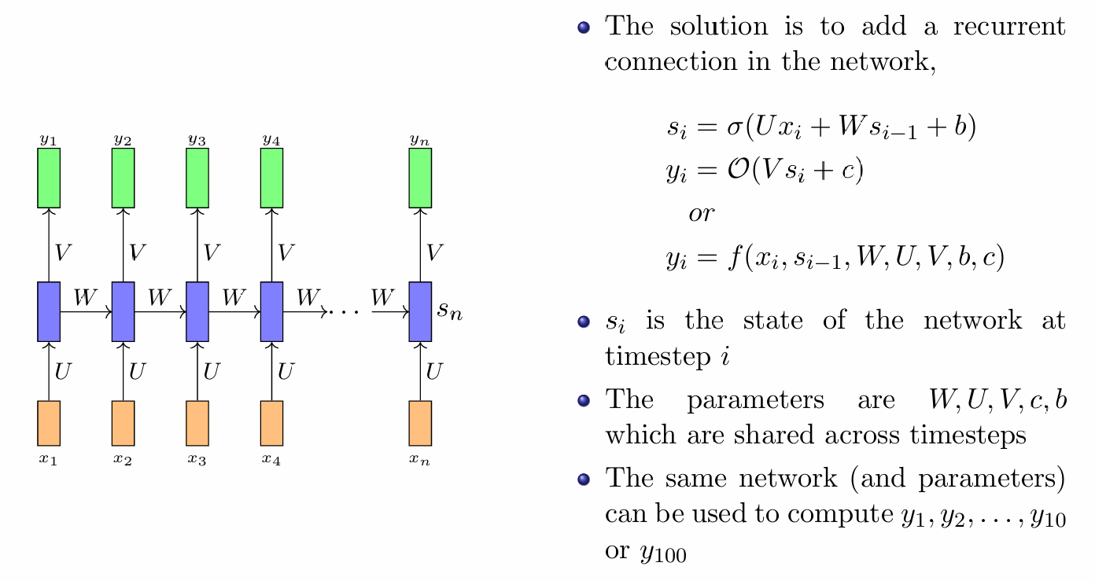
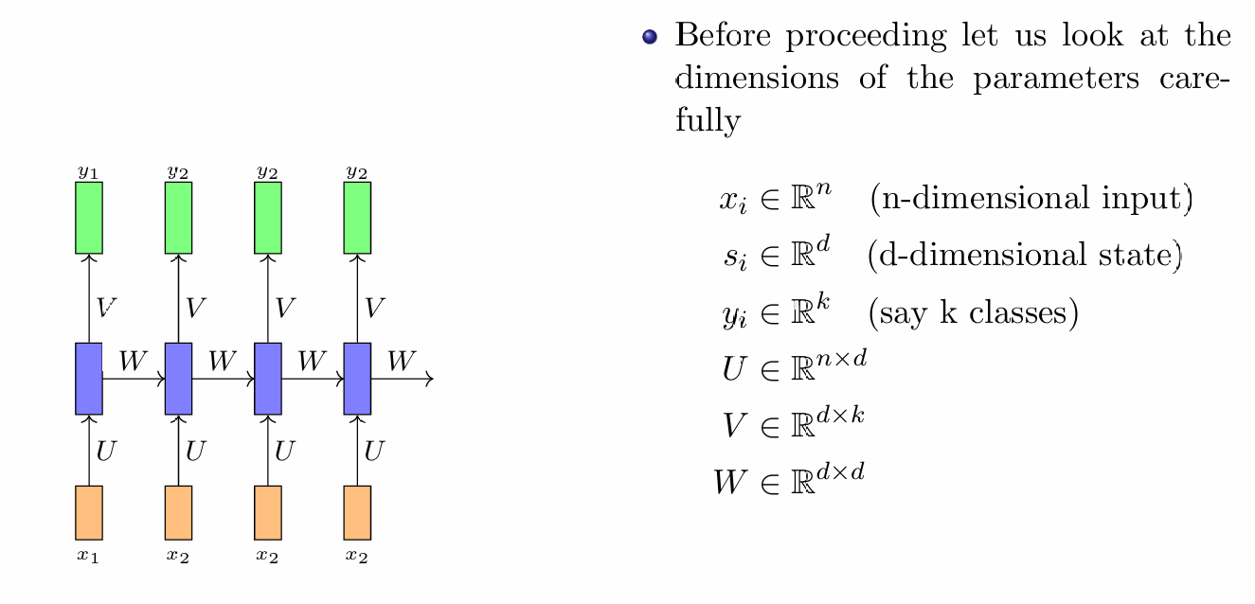
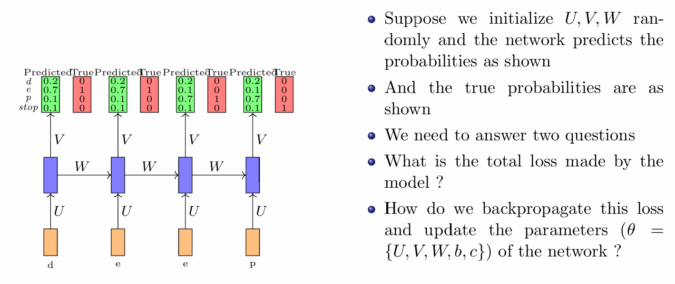
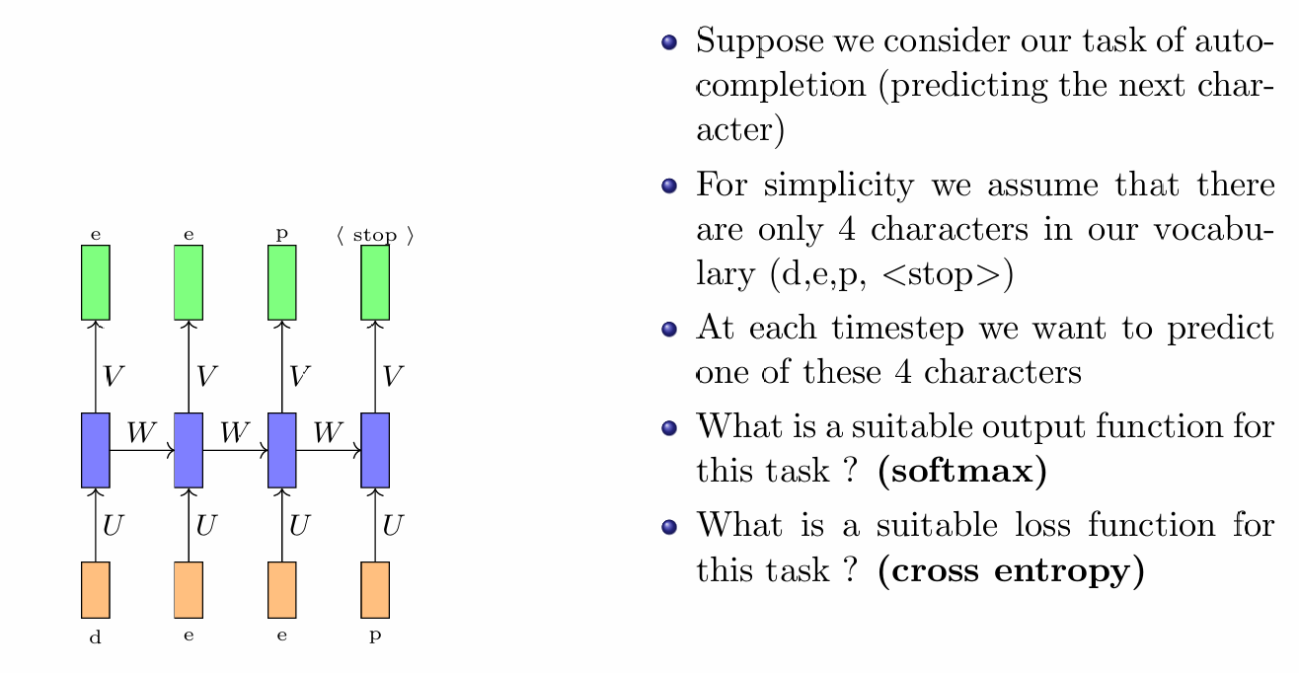
Backpropagation through time

Slide 5
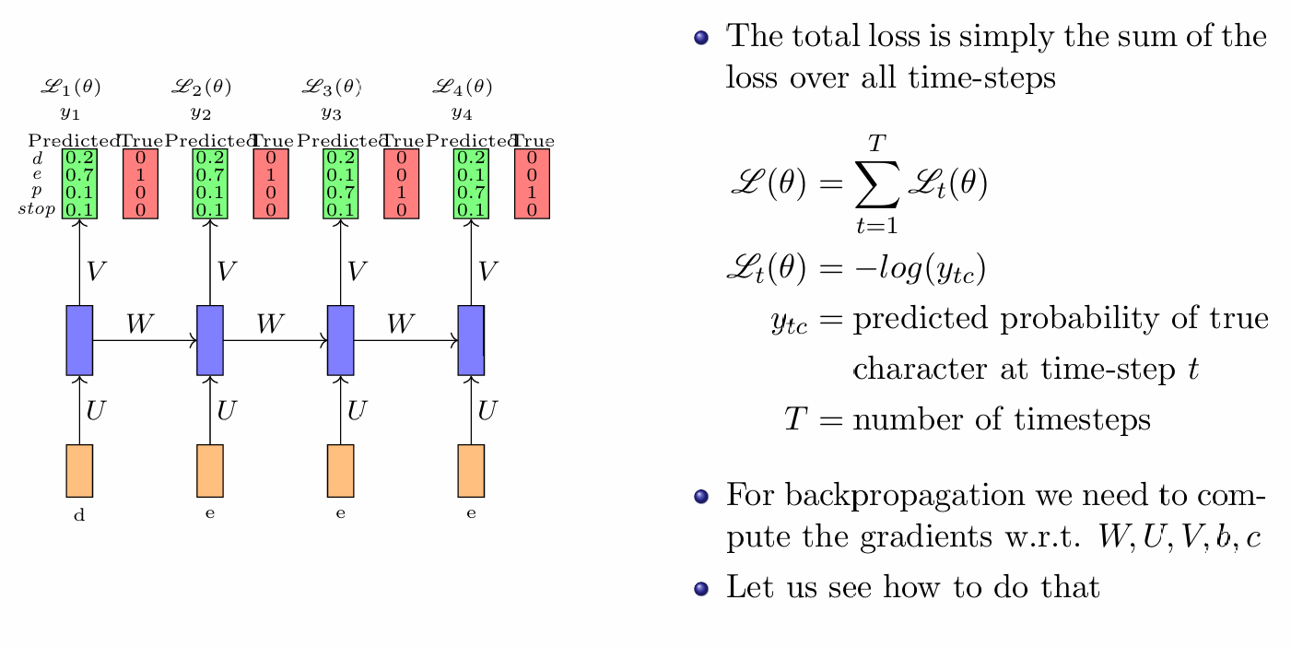
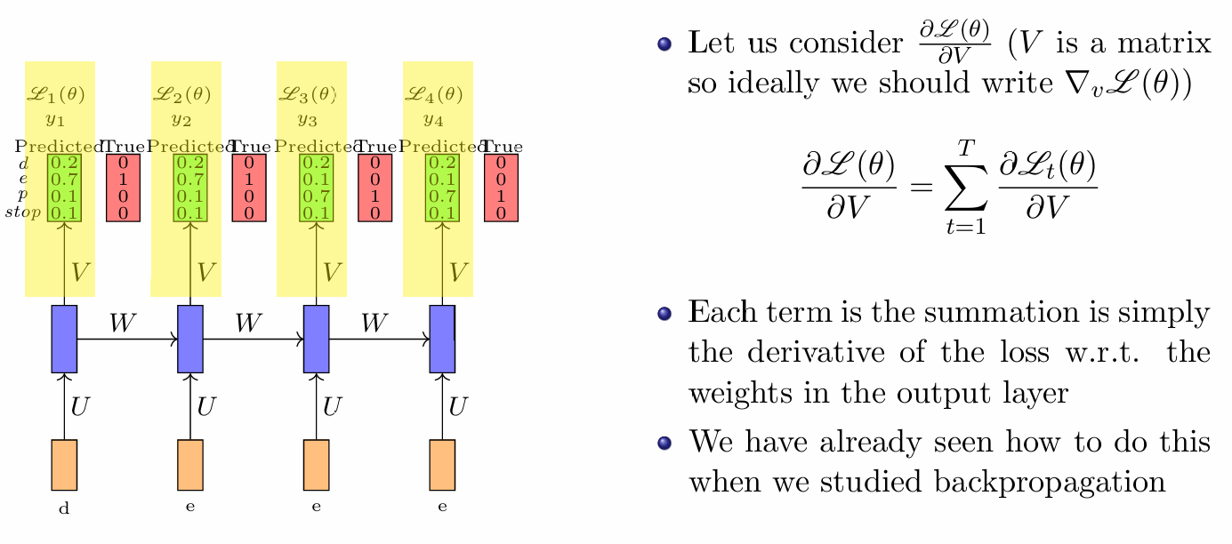
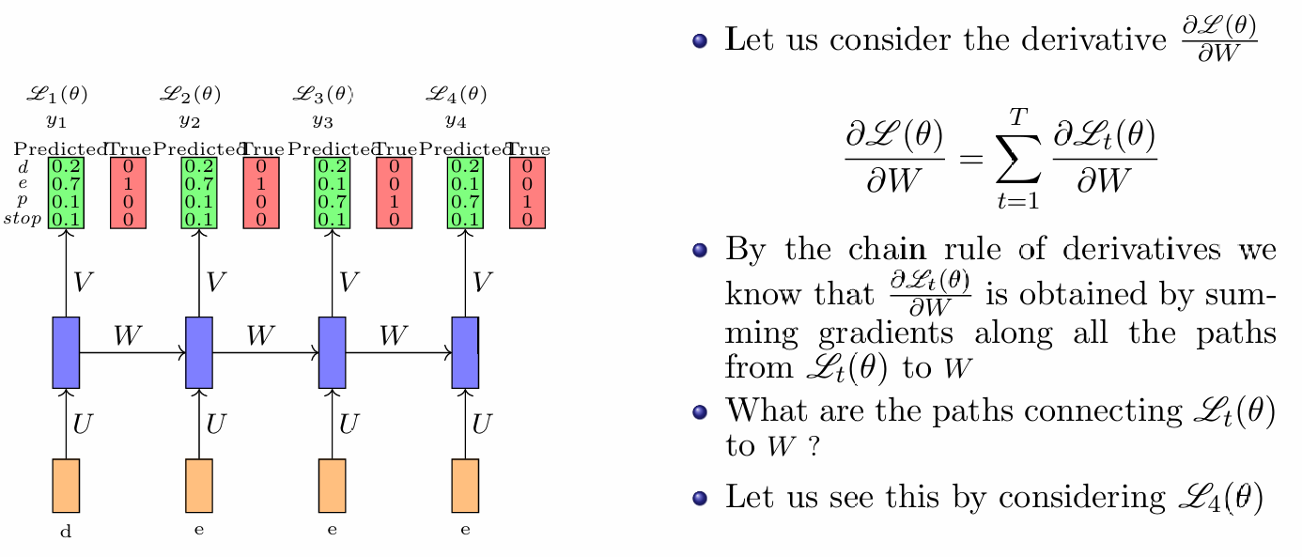
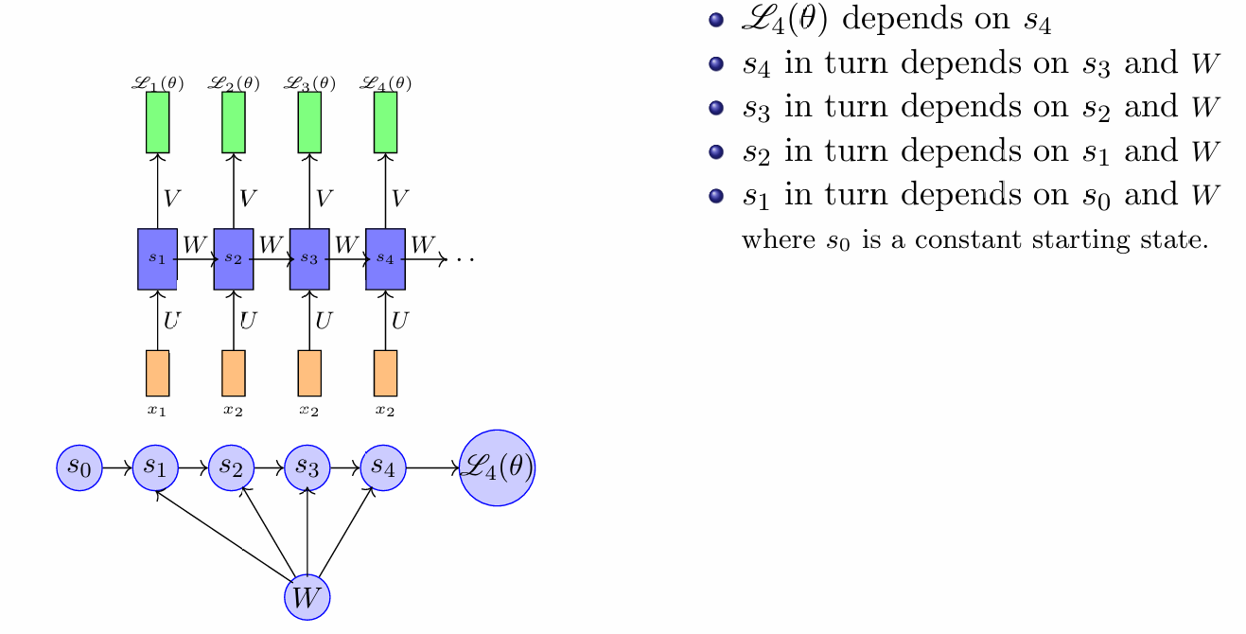

Slide 6
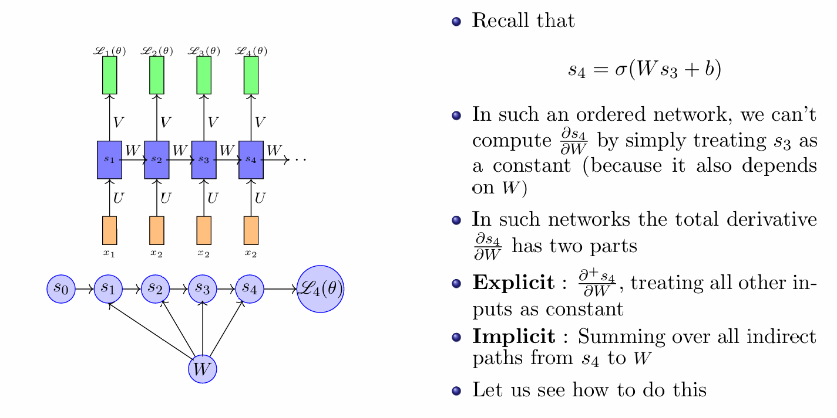
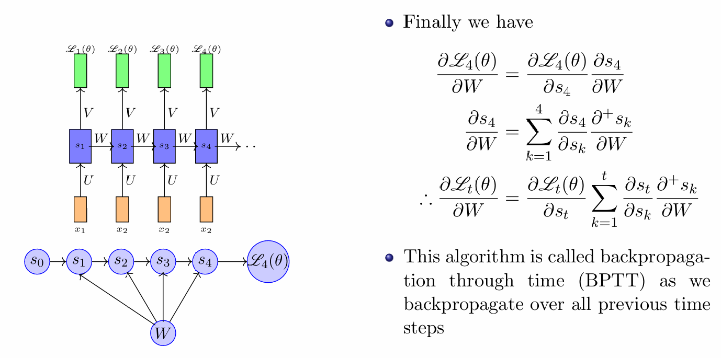
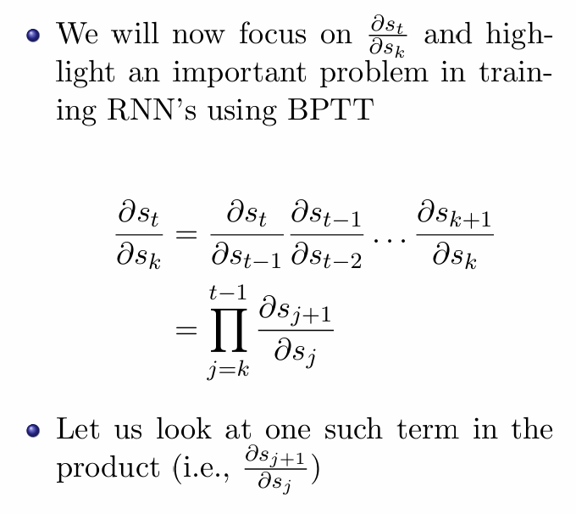
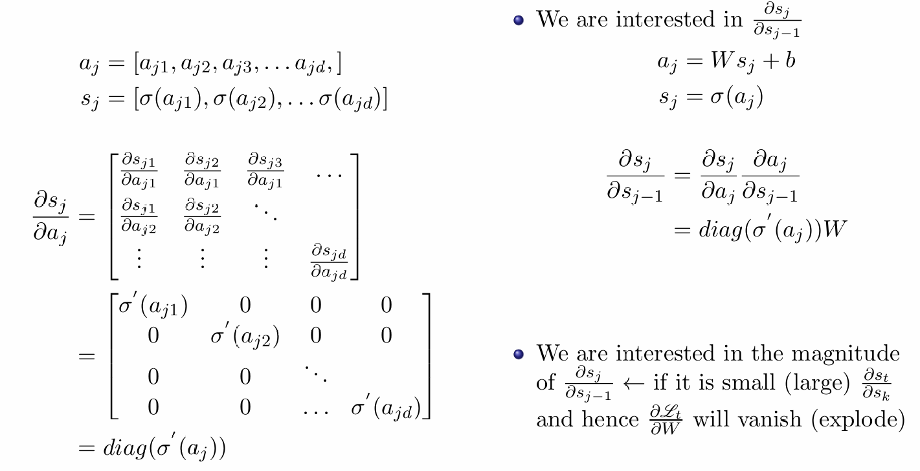
The problem of Exploding and Vanishing Gradients

Slide 7
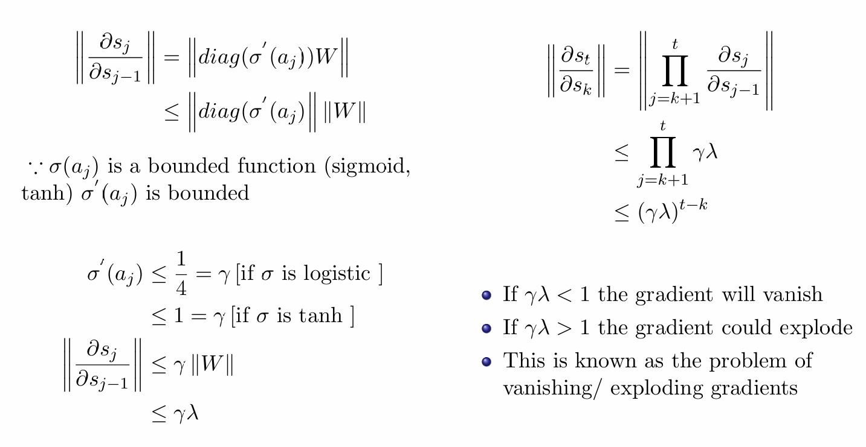
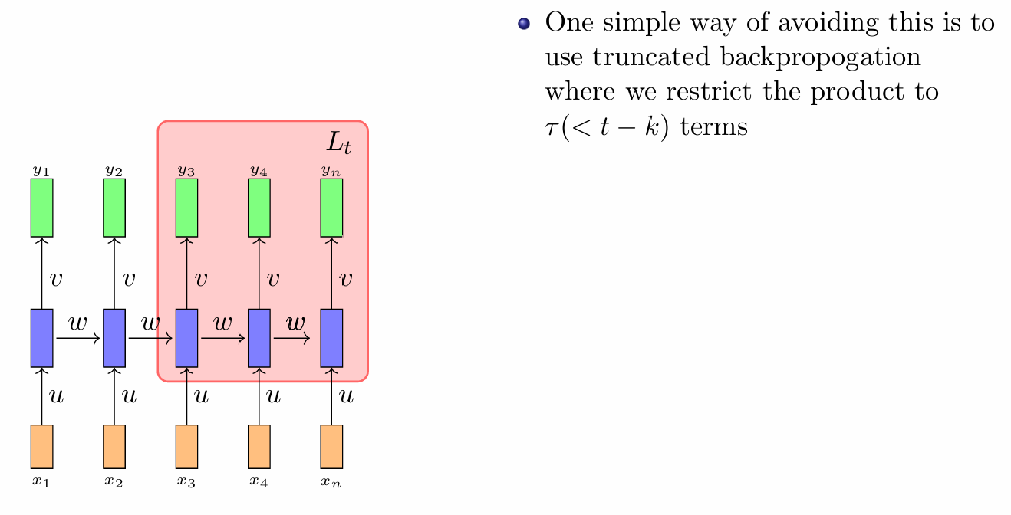
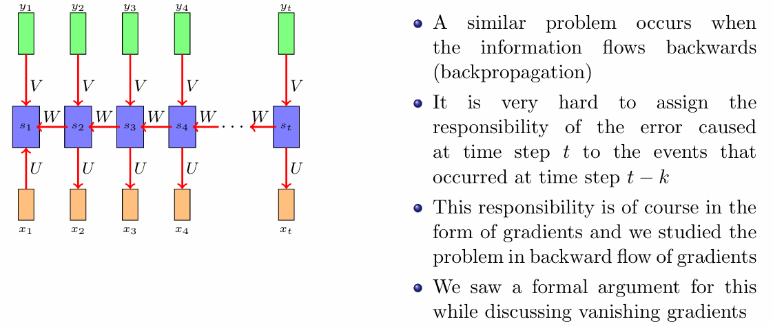
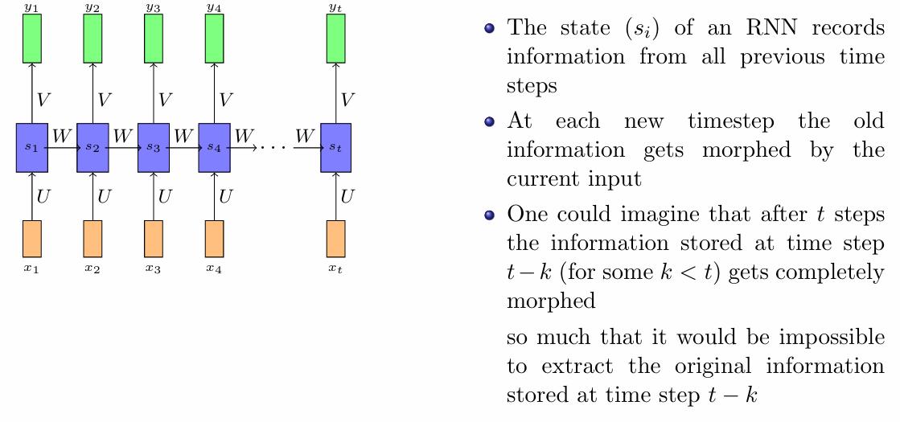
Selective Read, Selective Write, Selective Forget- The Whiteboard Analogy

Slide 8
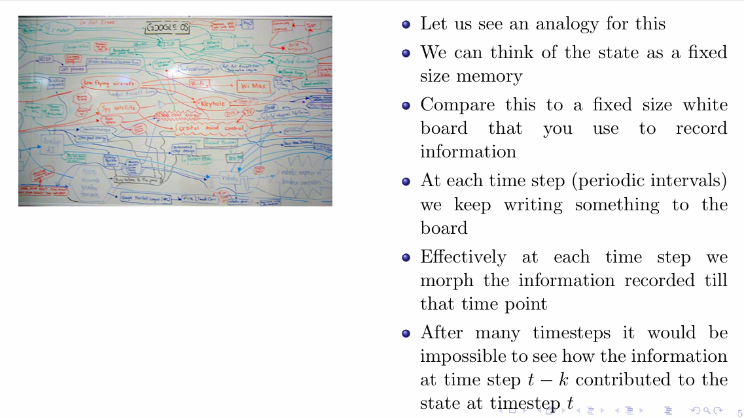
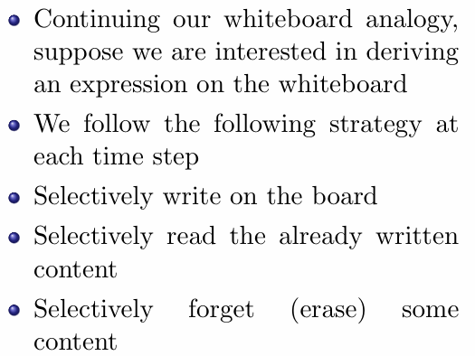
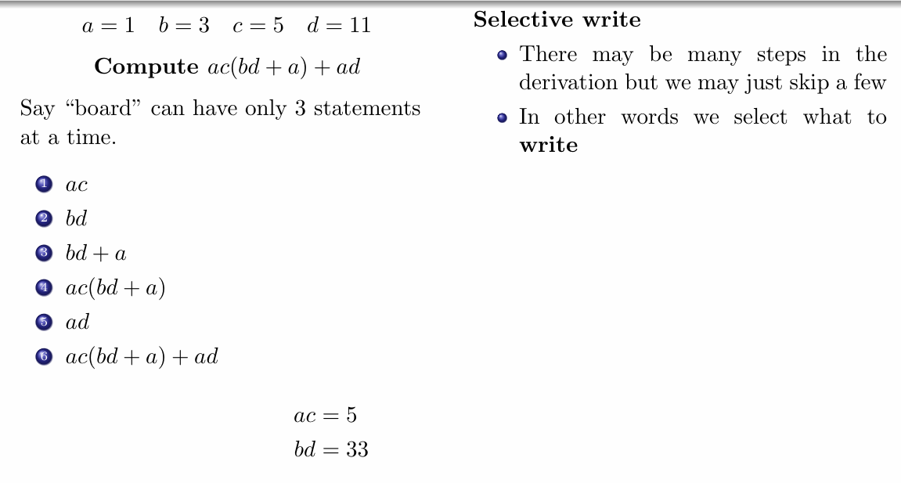
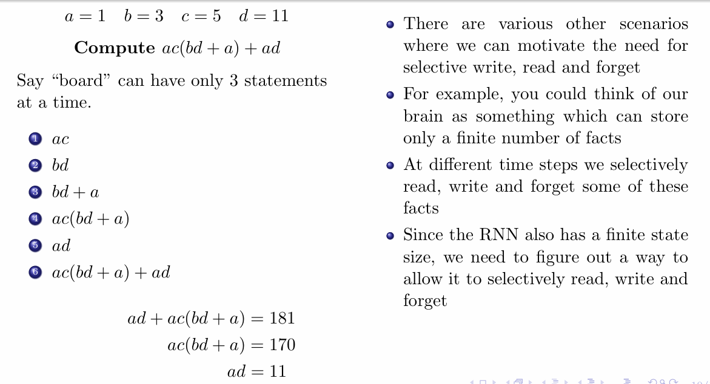
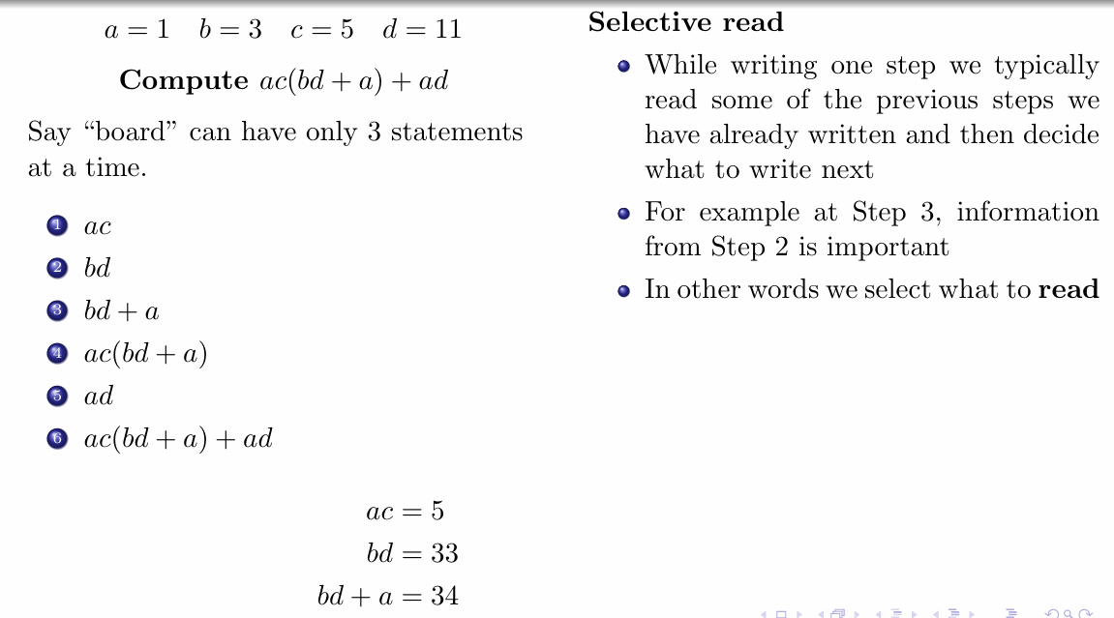
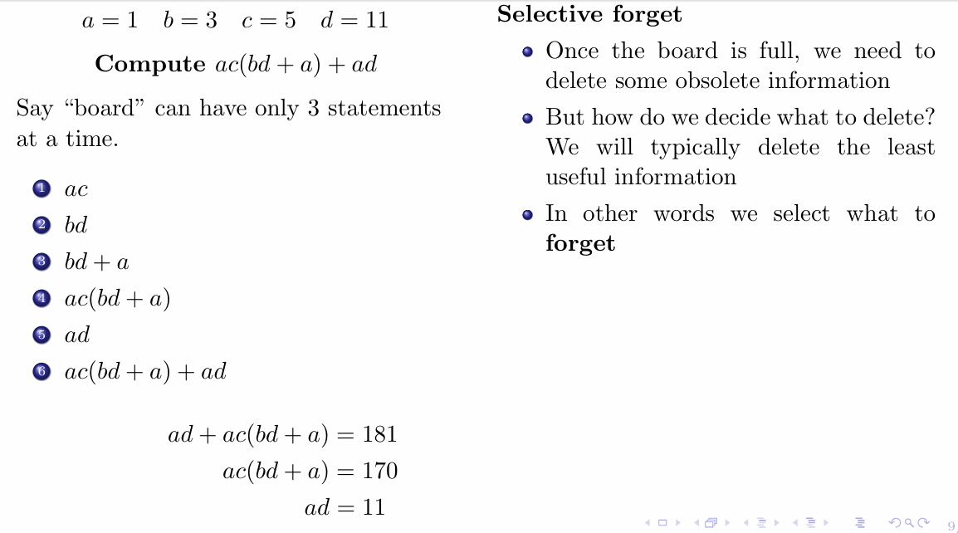

Slide 9
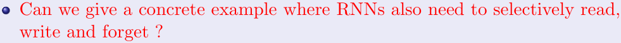
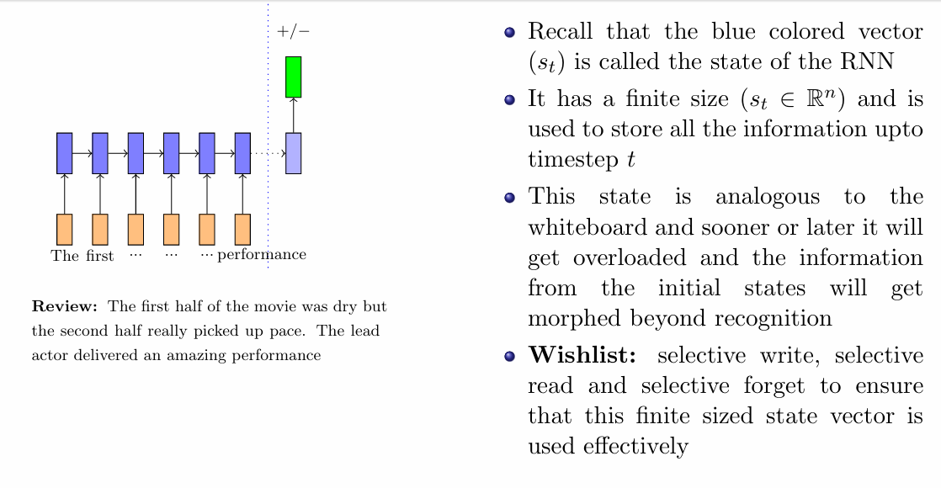
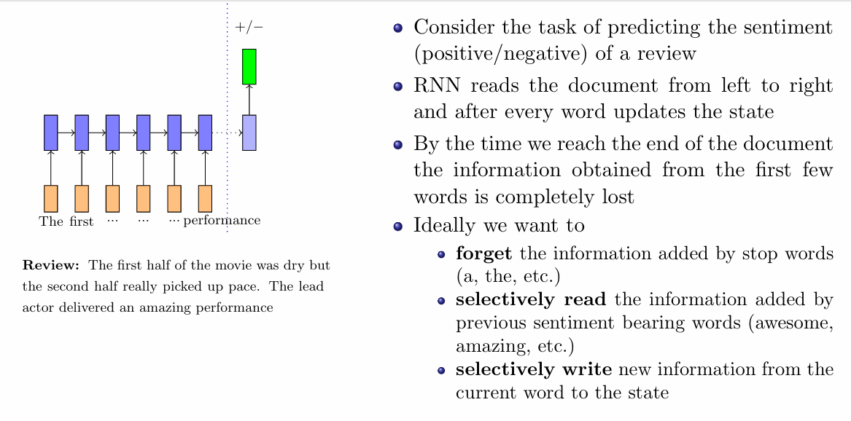
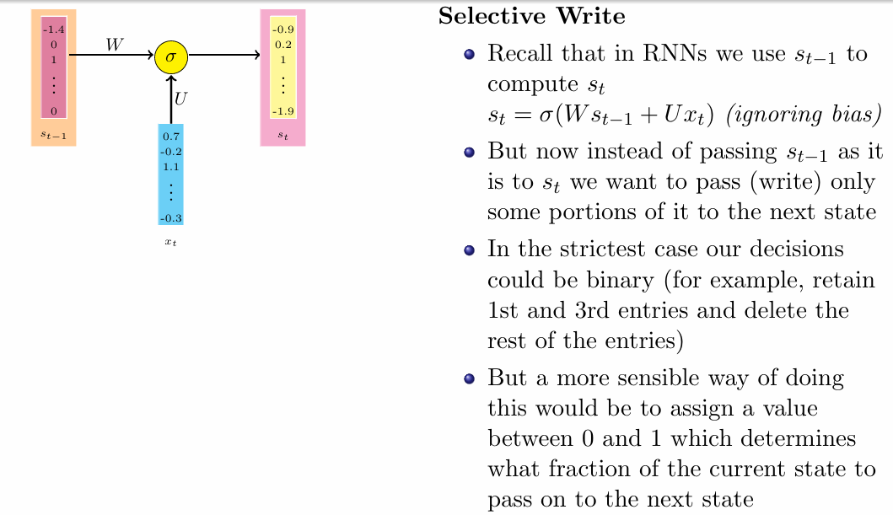
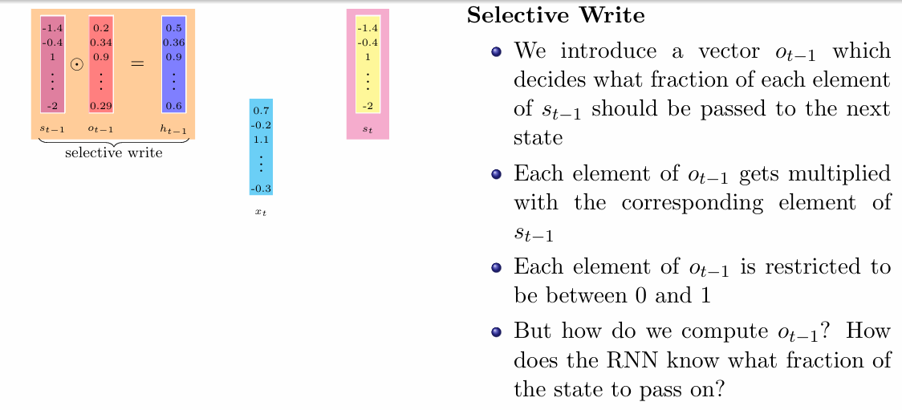
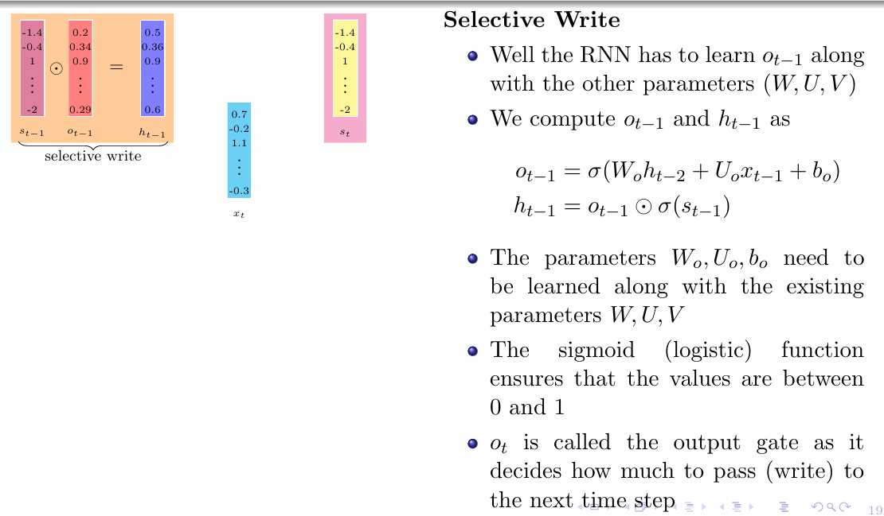
Long Short Term Memory(LSTM) and Gated Recurrent Units(GRUs)

Slide 10
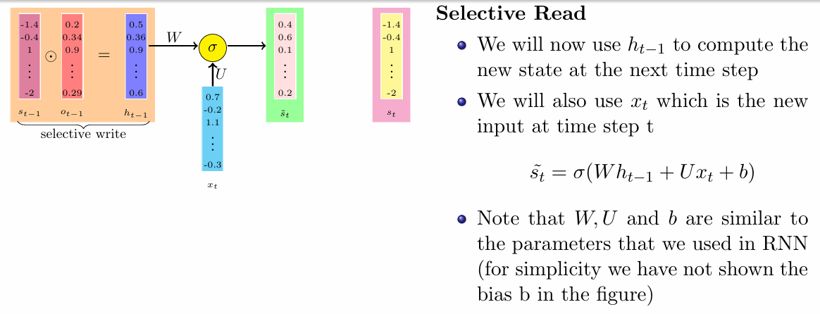
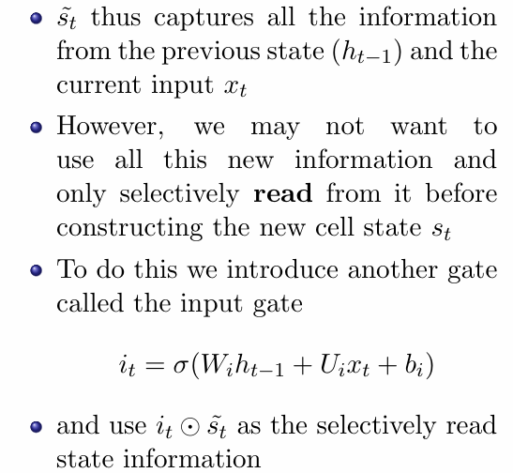
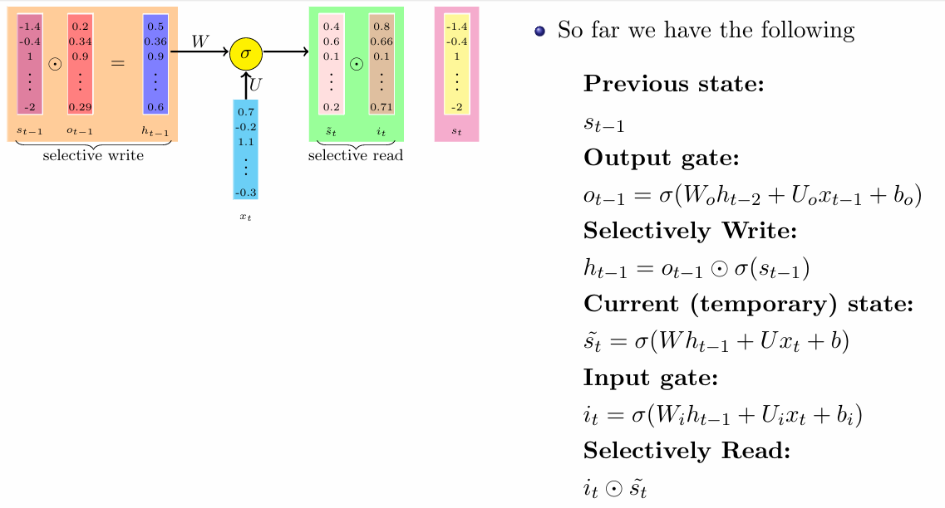
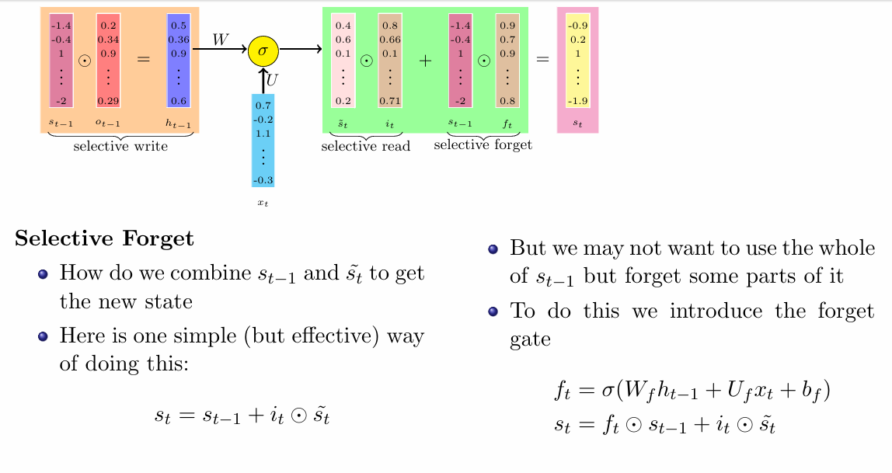

Slide 11
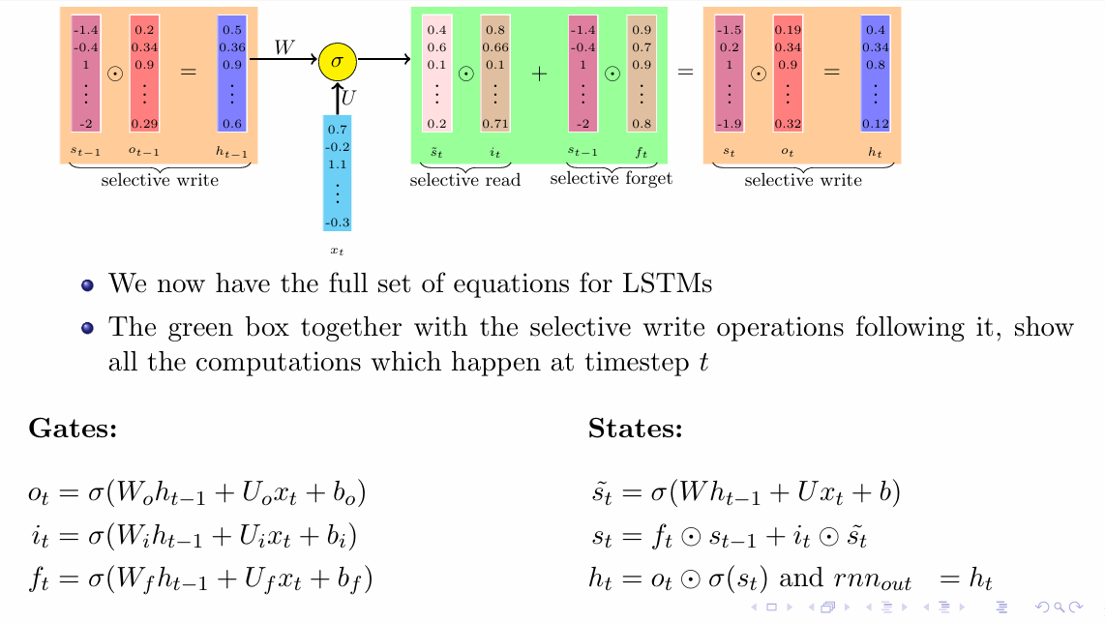
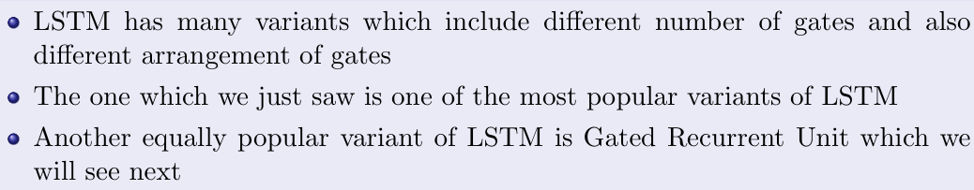
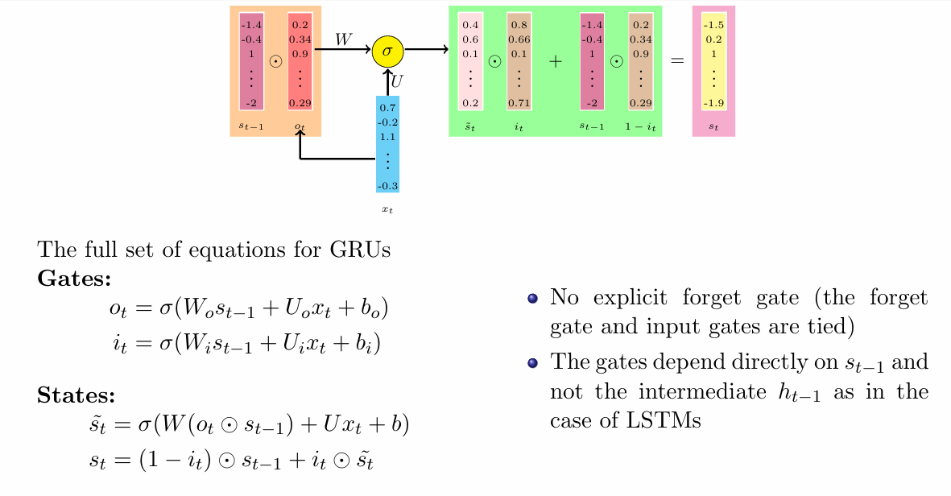

Slide 12
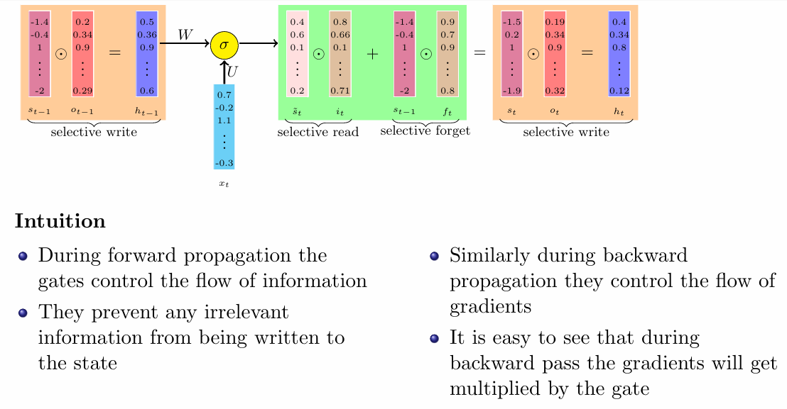
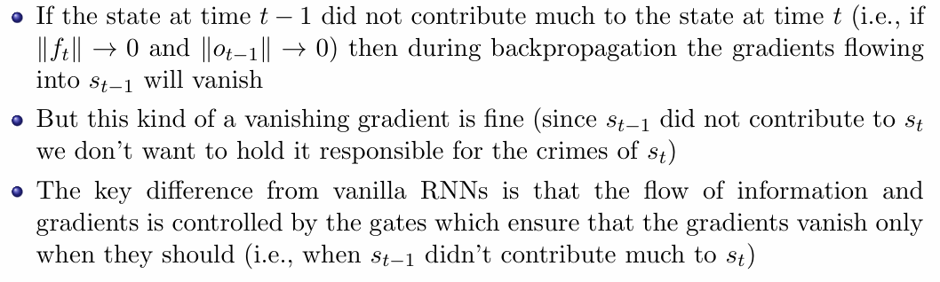
How LSTMs avoid the problem of vanishing gradients

Slide 13
Topics on which Week 11 Assignment Questions are based
Sequence Learning Problems
Recurrent Neural Networks
Backpropagation through time
Selective Read, Selective Write, Selective Forget- The Whiteboard Analogy
Long Short Term Memory(LSTM) and Gated Recurrent Units(GRUs)

Slide 14
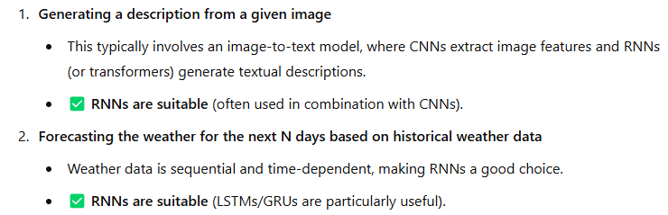

QUESTION 1
For which of the following problems are RNNs suitable?
Generating a description from a given image
Forecasting the weather for the next N days based on historical weather data
Converting a speech waveform into text
Identifying all objects in a given image
SOLUTION 1
CORRECT ANSWER 1
a), b), c)

Slide 15

QUESTION 2
What is the basic concept of Recurrent Neural Network?
Use a loop between inputs and outputs in order to achieve the better prediction
Use recurrent features from dataset to find the best answers
Use loops between the most important features to predict next output
Use previous inputs to find the next output according to the training set
SOLUTION 2
CORRECT ANSWER 2
d)

Slide 16



QUESTION 3
What is the main advantage of using GRUs over traditional RNNs?
They are simpler to implement
They solve the vanishing gradient problem
They require less computational power
They can handle non-sequential data
SOLUTION 3
CORRECT ANSWER 3
b)

Slide 17


QUESTION 4
The statement that LSTM and GRU solves both the problem of vanishing and exploding gradients in RNN is
True
False
SOLUTION 4
CORRECT ANSWER 4
b)

Slide 18



QUESTION 5
SOLUTION 5
CORRECT ANSWER 5
7600

Slide 19



QUESTION 6
Arrange the following sequence in the order they are performed by LSTM at time step t.
[Selectively read, Selectively write, Selectively forget]
Selectively read, Selectively write, Selectively forget
Selectively write, Selectively read, Selectively forget
Selectively read, Selectively forget, Selectively write
Selectively forget, Selectively write, Selectively read
SOLUTION 6
CORRECT ANSWER 6
c)

Slide 20




QUESTION 7
SOLUTION 7
CORRECT ANSWER 7
a)

Slide 21


QUESTION 8
Which of the following is a limitation of traditional feedforward neural networks in handling sequential data?
They can only process fixed-length input sequences
They are highly optimizable using the gradient descent methods
They can’t model temporal dependencies between sequential data
All of These
SOLUTION 8
CORRECT ANSWER 8
a), c)

Slide 22


QUESTION 9
SOLUTION 9
CORRECT ANSWER 9
d)

Slide 23



QUESTION 10
Which of the following is true about LSTM and GRU networks?
LSTM networks have more gates than GRU networks
GRU networks have more gates than LSTM networks
LSTM and GRU networks have the same number of gates
Both LSTM and GRU networks have no gates
SOLUTION 10
CORRECT ANSWER 10
a)

